Slide 1
Rap Irregular Verbs
ELIZABETH PÉREZ MAZO
DANIELA HINCAPIÉ CORREA
JOHNNY LEWIS DEOSSA CANO
ALEJANDRA CHANCI SUCERQUIA

Slide 2
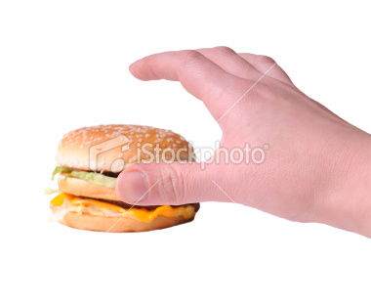
TAKE

Slide 3

SHAKE

Slide 4

WAKE

Slide 5

STYLE

Slide 6
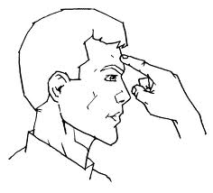
THINK

Slide 7
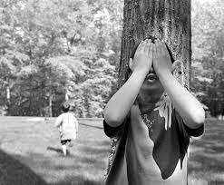
SEEK

Slide 8

TEACH

Slide 9

SLEEP

Slide 10
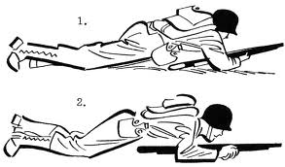
CREEP

Slide 11
SNEAK

Slide 12

LEAP

Slide 13
KEEP

Slide 14
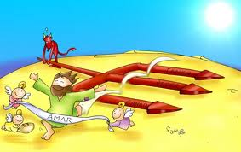
BEAT

Slide 15

WIN

Slide 16

DO

Slide 17

BEGIN

Slide 18
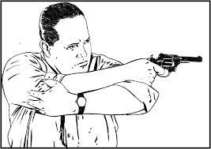
SHOOT

Slide 19

LEAD

Slide 20
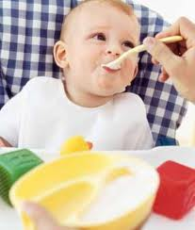
FEED

Slide 21
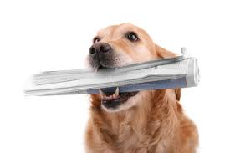
BRING

Slide 22
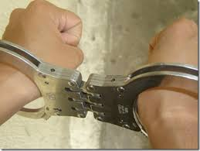
CATCH

Slide 23
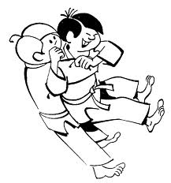
FIGTH

Slide 24

Freeze
Parrafo 3

Slide 25

speak

Slide 26

steal

Slide 27
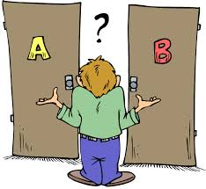
choose

Slide 28

write

Slide 29
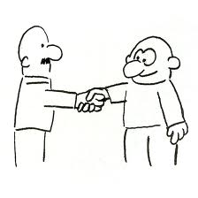
meet

Slide 30

bet

Slide 31
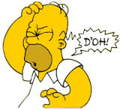
forget

Slide 32
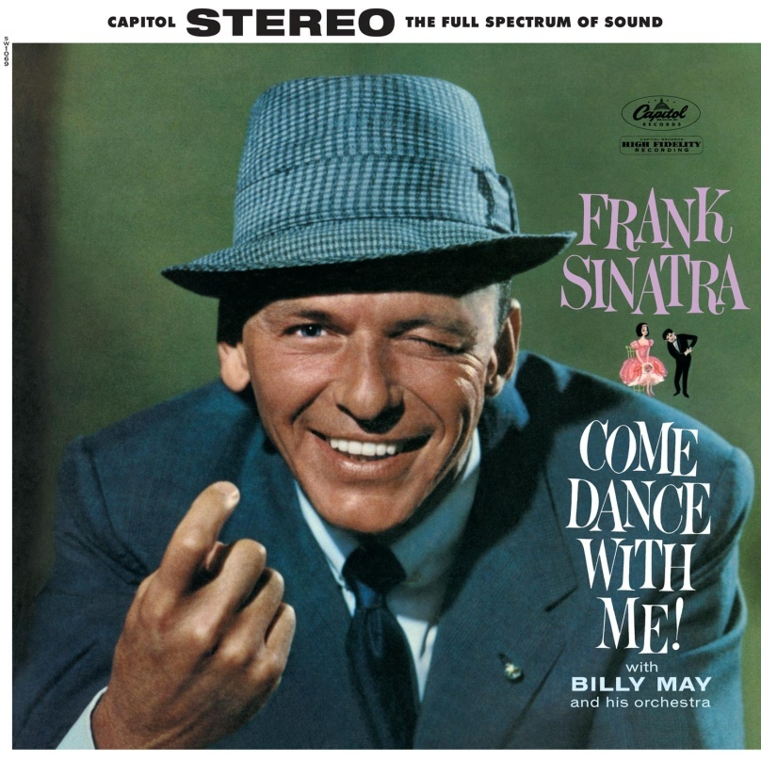
come

Slide 33
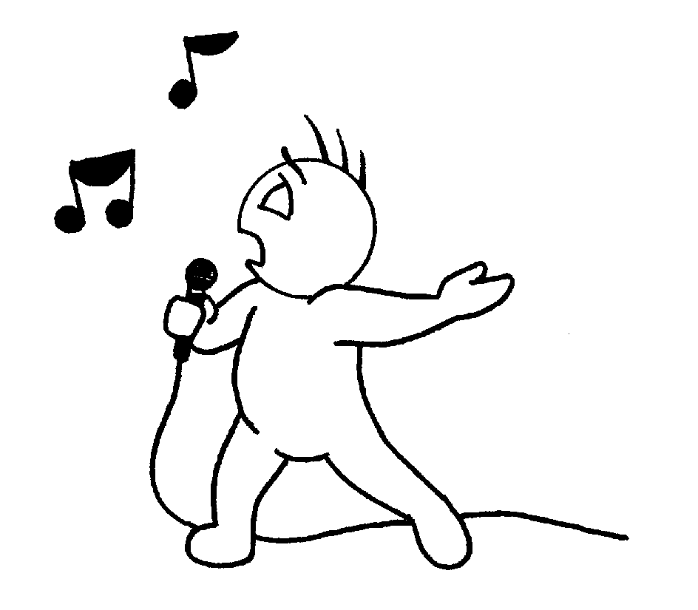
sing

Slide 34
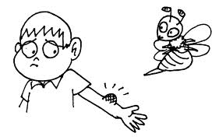
sting

Slide 35
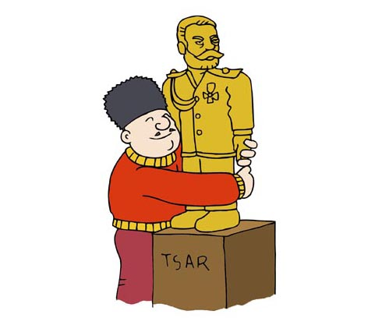
cling

Slide 36
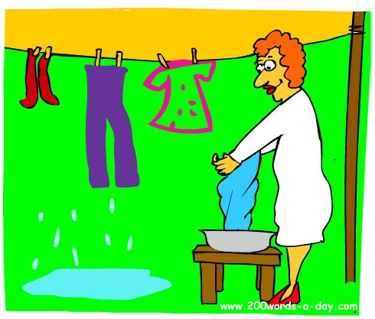
hang

Slide 37

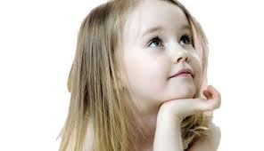
Dream

Slide 38
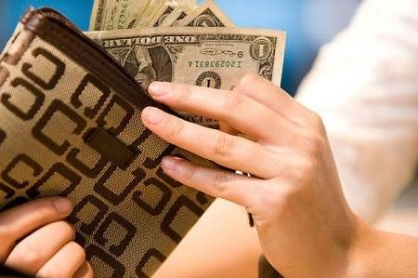
Spend

Slide 39

Lend

Slide 40
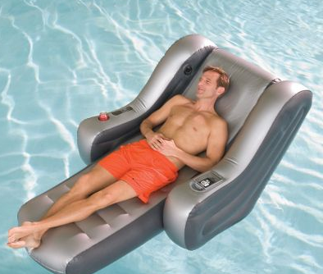
Lay

Slide 41

Make

Slide 42
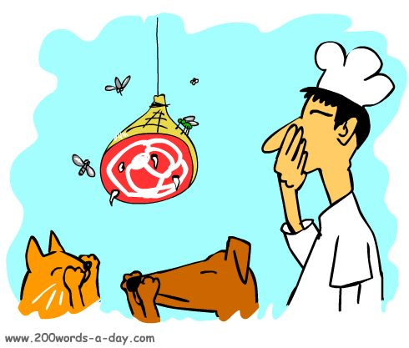
Stink

Slide 43

Drink

Slide 44
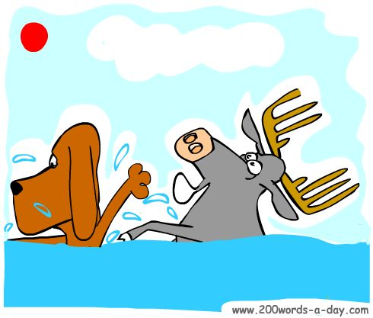
Sink

Slide 45
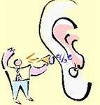
Hear

Slide 46
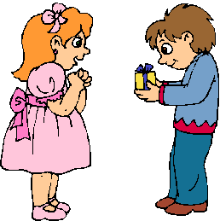
Give

Slide 47
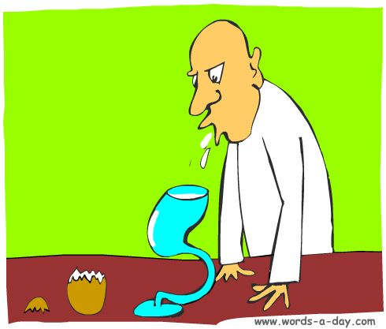
Spit

Slide 48

Quit

Slide 49
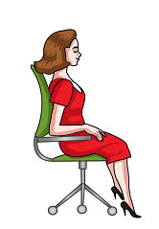
Sit

Slide 50
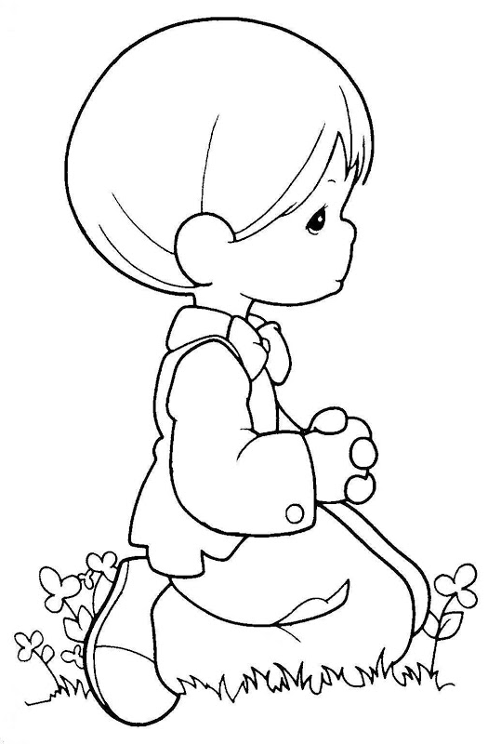
Kneel

Slide 51

Feel

Slide 52

RISE

Slide 53
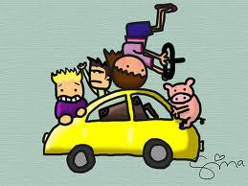
DRIVE

Slide 54
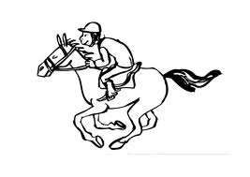
RIDE

Slide 55

HIDE

Slide 56

FIND

Slide 57
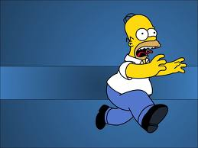
FLEE

Slide 58

See

Slide 59
Mean

Slide 60

Send

Slide 61

Show

Slide 62
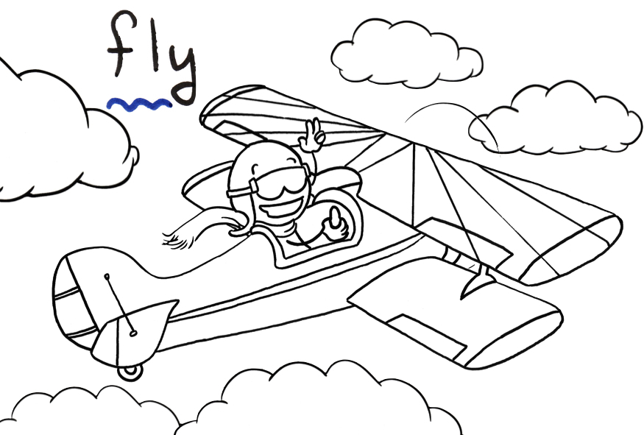
Fly

Slide 63

Know

Slide 64

Shine

Slide 65
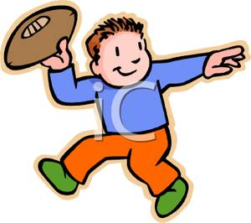
throw

Slide 66

grow

Slide 67

Draw

Slide 68

Go

